Slide 1

Name: Ayesha Nawaz Khan
Topic: Multimedia

Slide 2
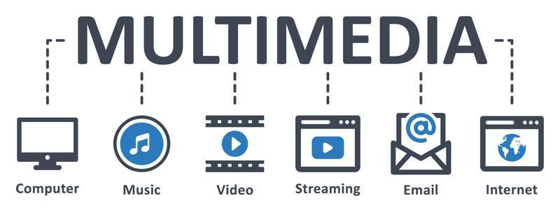
Introduction, Merits and Demerits, Applications, and Working

Slide 3
Introduction to Multimedia
Multimedia combines different types of media: text, audio, images, video, and animation. Its goal is to make communication more engaging and effective.

Slide 4


Slide 5
MERITS AND DEMERITS
MERITS:
Engaging and interactive
Better communication of complex ideas
Versatile for various fields
DEMERITS:
High production cost
Requires technical expertise
Needs significant storage space

Slide 6

Applications of Multimedia
Education

Slide 7
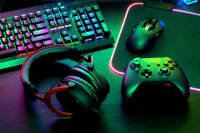
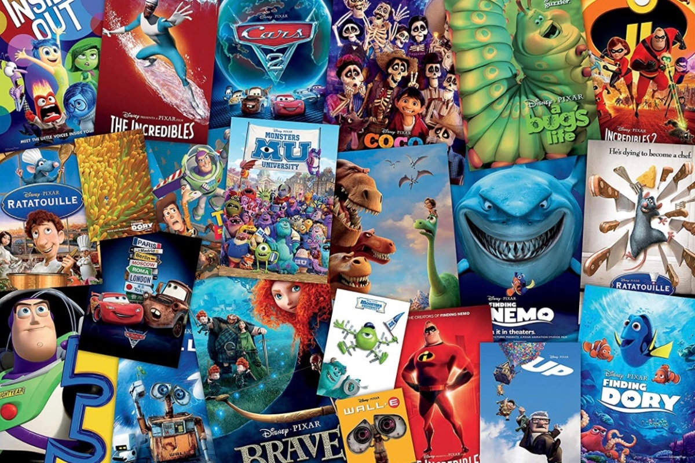
Entertainment
VIDEO GAMES
MOVIES

Slide 8

ADVERTISMENT

Slide 9

HEALTHCARE

Slide 10
Working of Multimedia
- Data processing: Multimedia elements are processed and encoded
- Storage and retrieval: Multimedia data is stored and accessed as needed
- User interaction: Users can control the experience (interactive)
- Playback: Multimedia is rendered using players or browsers

Slide 11
QUESTIONS

Slide 12
THANK YOU

